Slide 1

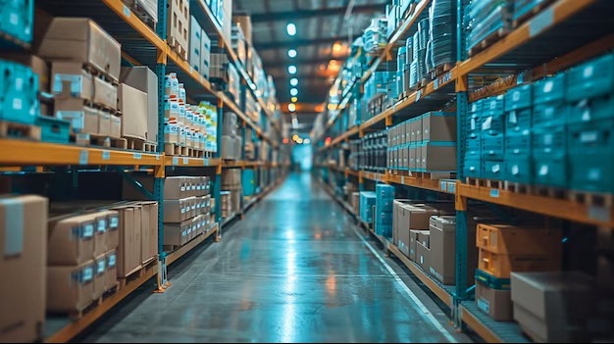

- Topic -
Inventory & Raw Material
Analysis
Presented By-
Name : Suyash Kadu
ID : #21395
Mail ID : Suyashkadu11@gmail.com

Slide 2
Inventory

Slide 3
Deliveries
“Refers to the receipt of raw materials or goods from suppliers. It tracks the timeliness, quantity, and quality of items delivered against purchase orders.”
Inventory

Slide 4
Deliveries
Material Usage
“Refers to the receipt of raw materials or goods from suppliers. It tracks the timeliness, quantity, and quality of items delivered against purchase orders.”
“Represents how raw materials are consumed in production. It helps measure efficiency by comparing actual consumption with planned or standard usage.”
Inventory

Slide 5
Deliveries
Material Usage
“Refers to the receipt of raw materials or goods from suppliers. It tracks the timeliness, quantity, and quality of items delivered against purchase orders.”
“Represents how raw materials are consumed in production. It helps measure efficiency by comparing actual consumption with planned or standard usage.”
Inventory
Wastage & Scrap
“The portion of raw materials lost during handling or production due to errors, inefficiency, or defects, reducing overall yield.”

Slide 6
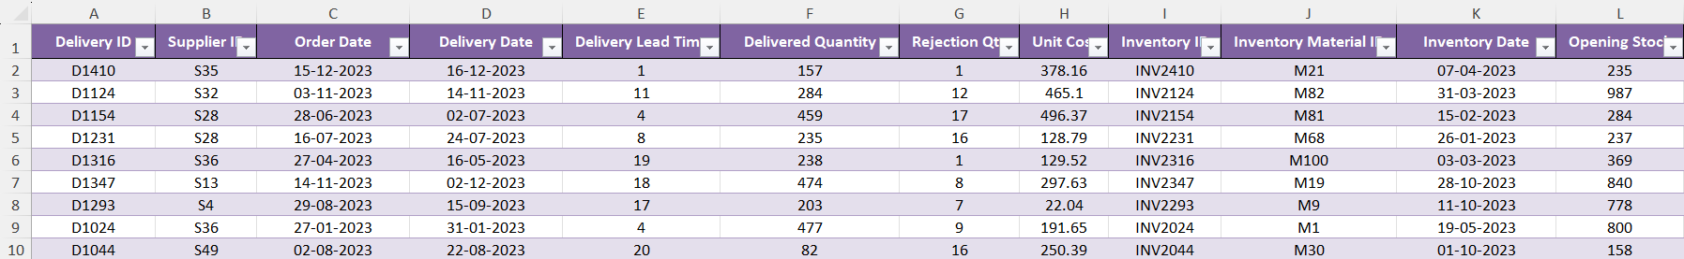
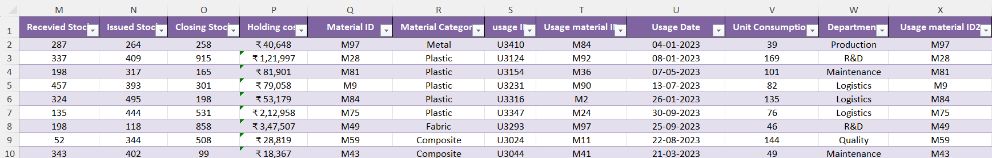
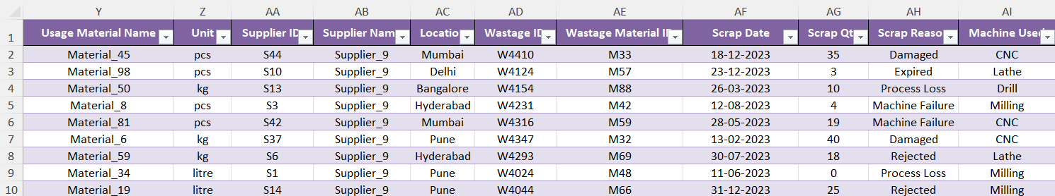
Dataset Table

Slide 7
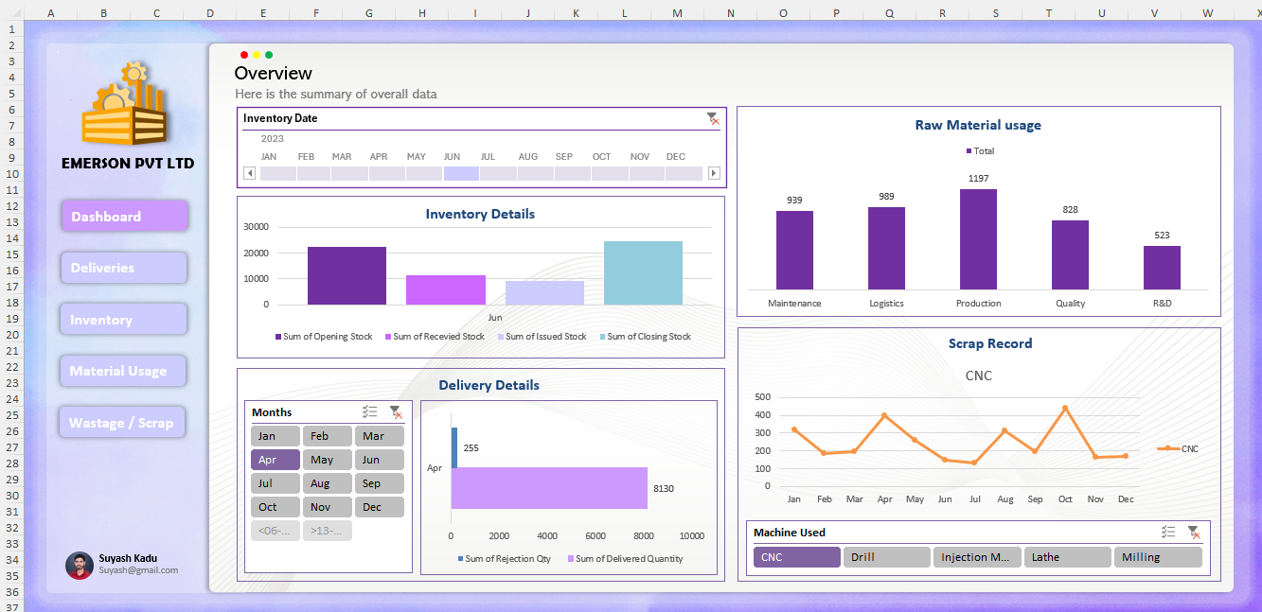
Dashboard

Slide 8
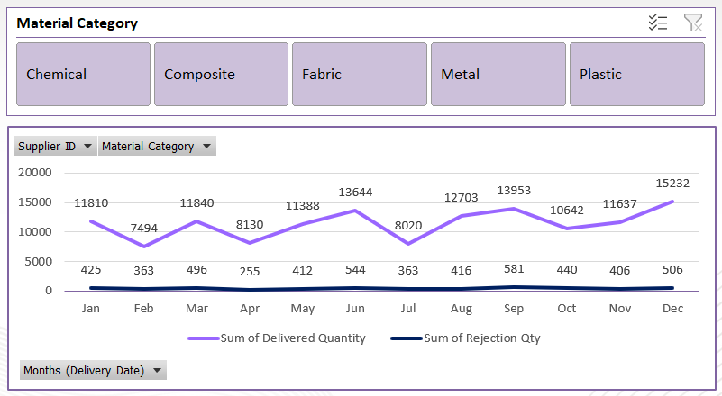


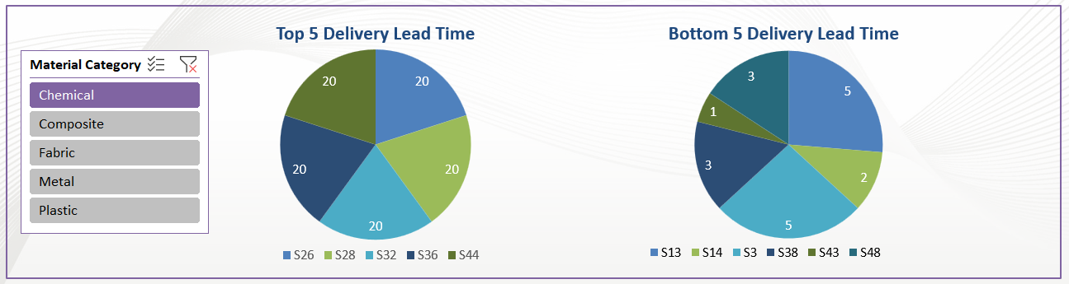
Delivery Insights
Here, I have created a line chart that represents the sum of delivery quantity and rejected quantity. I have also added a slicer to filter by material category.
In addition, I used a pie chart to represent the Top 5 and Bottom 5 supplier delivery lead times.

Slide 9
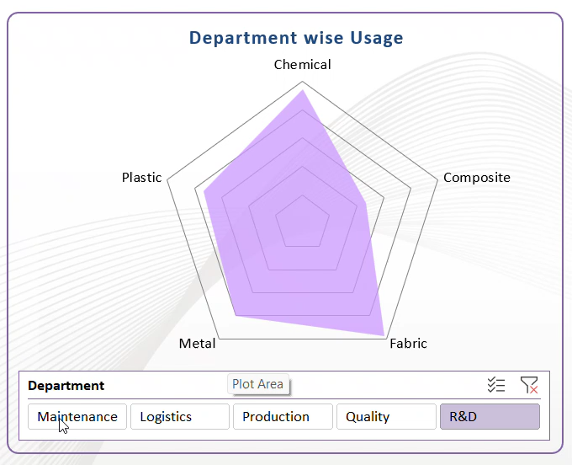
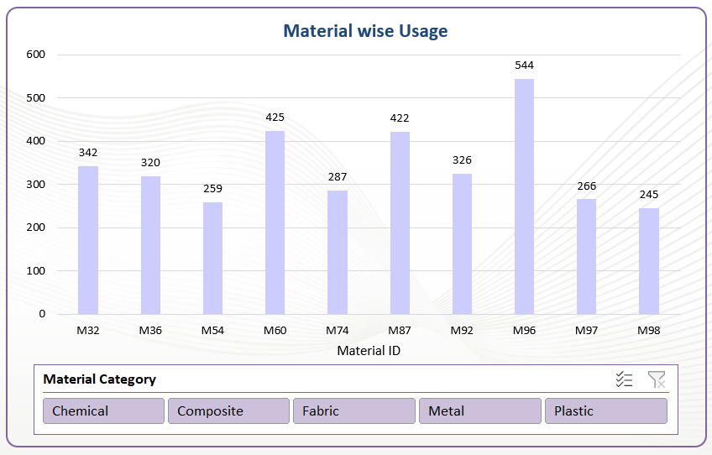
Material Usage Insights
A filled radar chart has been utilized to provide a clear visualization of department-wise raw material usage, categorized into five key material groups: chemicals, composites, fabrics, metals, and plastics.
On the other hand, category-wise consumption is also shown using a bar chart, which represents the top 10 most highly consumed raw materials.

Slide 10
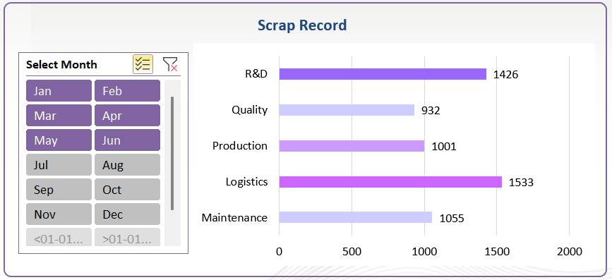
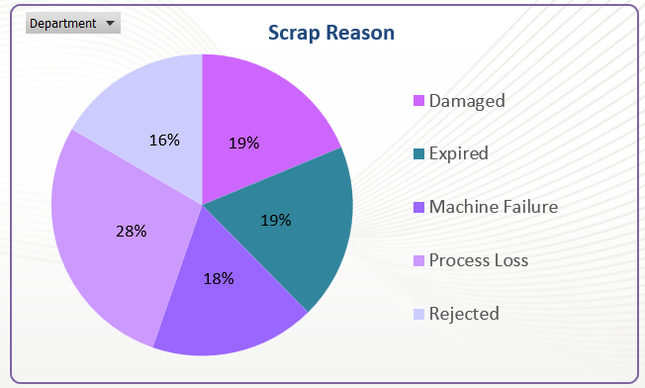
Wastage & Scrap
To analyze scrap generation, a clustered bar chart was used to represent the total quantity of scrap generated by each department. Additionally, an interactive slicer was incorporated, allowing users to filter and view the scrap generated across different months.
To gain deeper insights at the machine level, a pie chart was developed to show the percentage contribution of individual machines to the total scrap generated. This visualization makes it easier to identify machines that are underperforming or causing excessive wastage.

Slide 11
Advantages & Limitations
Advantages
Limitations
Centralized View of Data
Brings multiple charts, and insights together in one place, reducing the need to check multiple reports.
Overload of Information
Too many visuals or KPIs can make the dashboard confusing instead of insightful.
Quick Decision-Making
Visualizations (charts, graphs, slicers) make it easier for managers to spot trends, outliers, and problem areas quickly.
Data Dependency
If the source data is inaccurate, outdated, or incomplete, the dashboard will also show misleading results.
Interactive Analysis
Filters and slicers options allow users to explore data dynamically without needing technical expertise.
Maintenance Requirement
Dashboards need regular updates, validation, and sometimes redesigns to stay relevant.

Slide 12
- Topic -
Inventory & Raw Material Analysis
THANK YOU
Presented By-
Name : Suyash Kadu
ID : #21395
Mail ID : Suyashkadu11@gmail.com

